Slide 1
Pumps and Pumping Systems
Types
Performance evaluation
Efficient system operation
Flow control strategies
Energy conservation opportunities

Slide 2
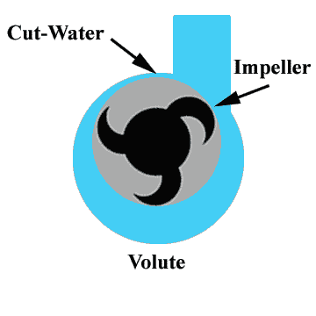
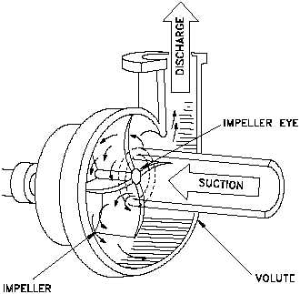
Pumps and Pumping Systems
Centrifugal Pumps

Slide 3
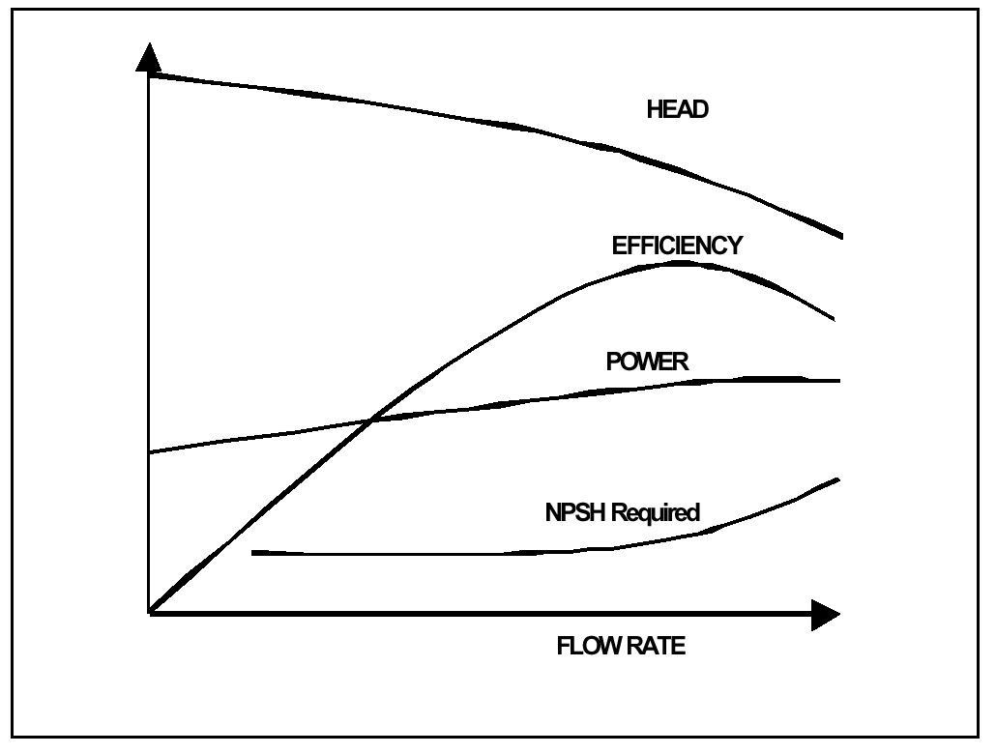
Pump Performance Curve

Slide 4
Hydraulic power, pump shaft power and electrical input power
Hydraulic power P_{h} = Q (m³/s) x Total head, h_{d} - h_{s} (m) x  (kg/m³) x g (m²/s) 1000
Where h_{d} - discharge head, h_{s} – suction head,  - density of the fluid, g – acceleration due to gravity
Pump shaft power P_{s} = Hydraulic power, P_{h} pump efficiency, _{Pump}
Electrical input power = Pump shaft power P _{Motor}

Slide 5
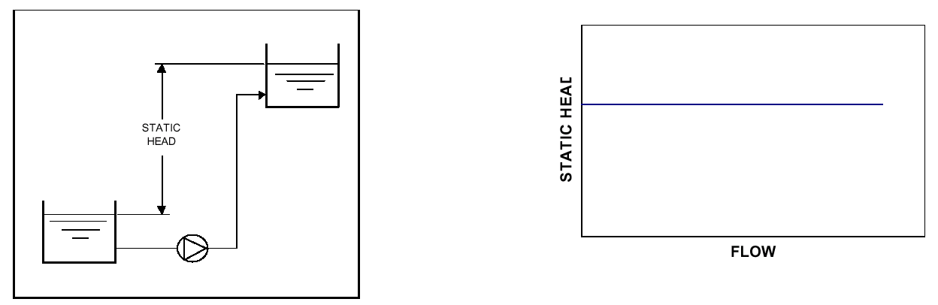
System Characteristics
Static Head
Static Head vs. Flow

Slide 6
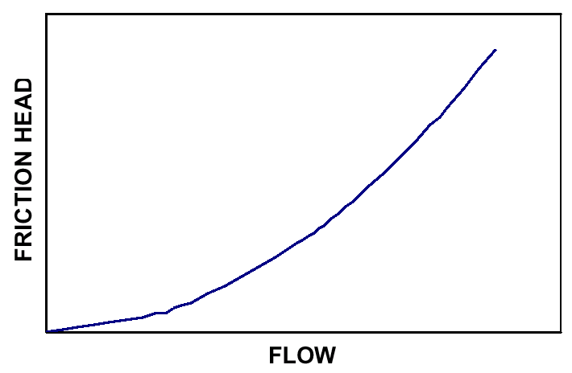
Dynamic (Friction) Head
Friction Head vs. Flow

Slide 7
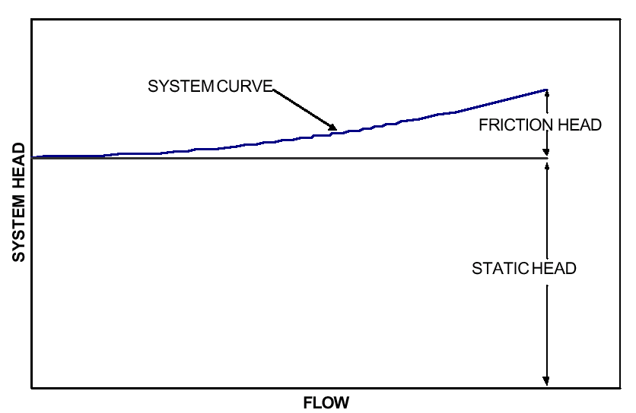
System with high static head

Slide 8
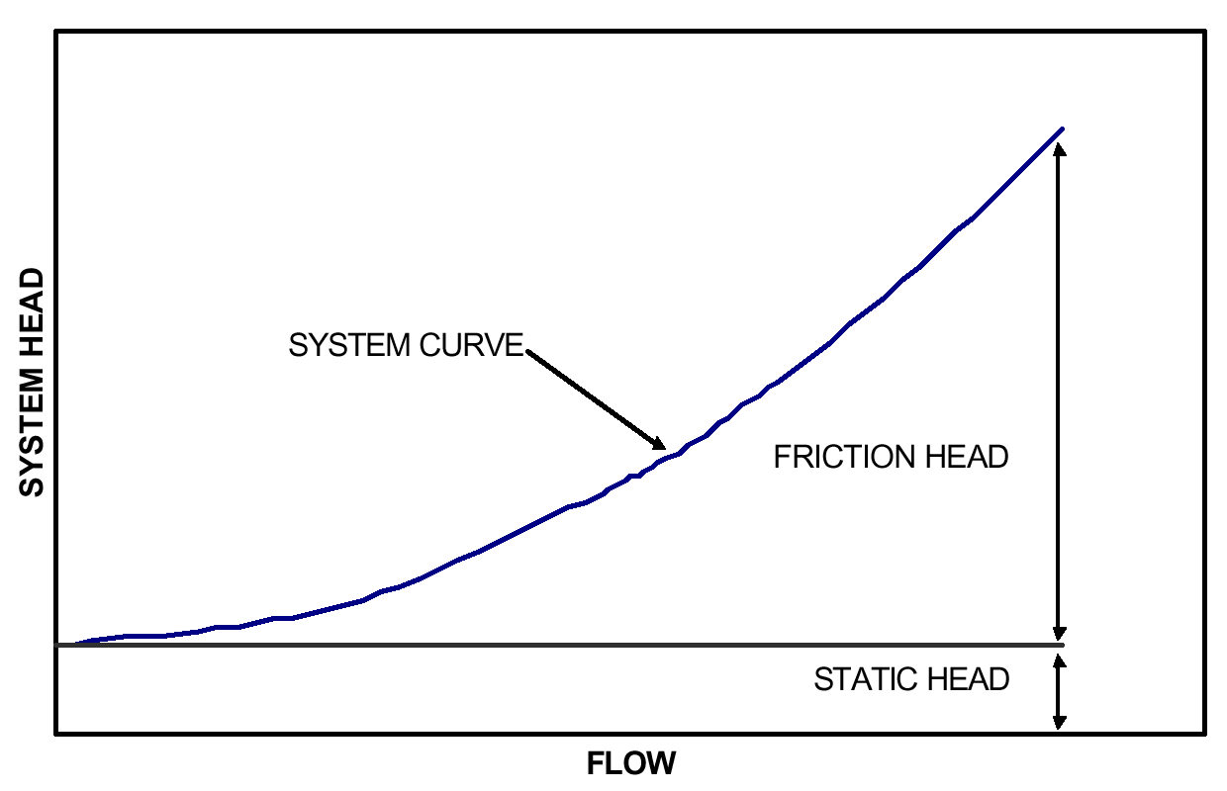
System with low static head

Slide 9
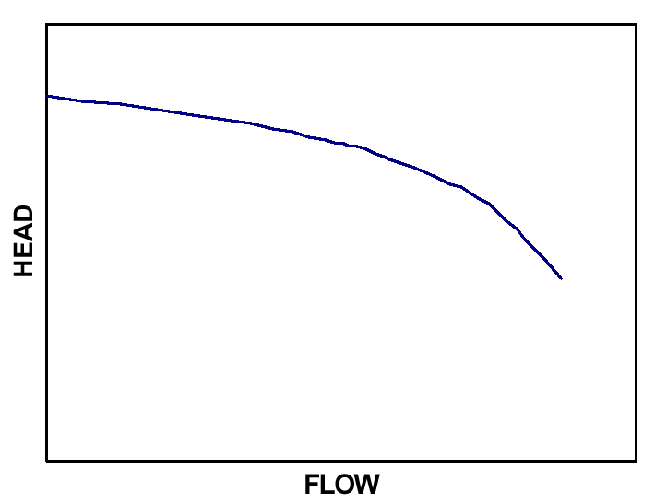
Pump curve

Slide 10
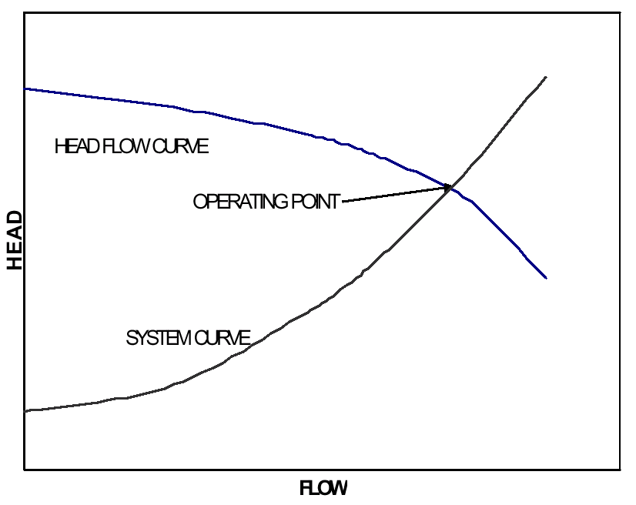
Pump operating point

Slide 11
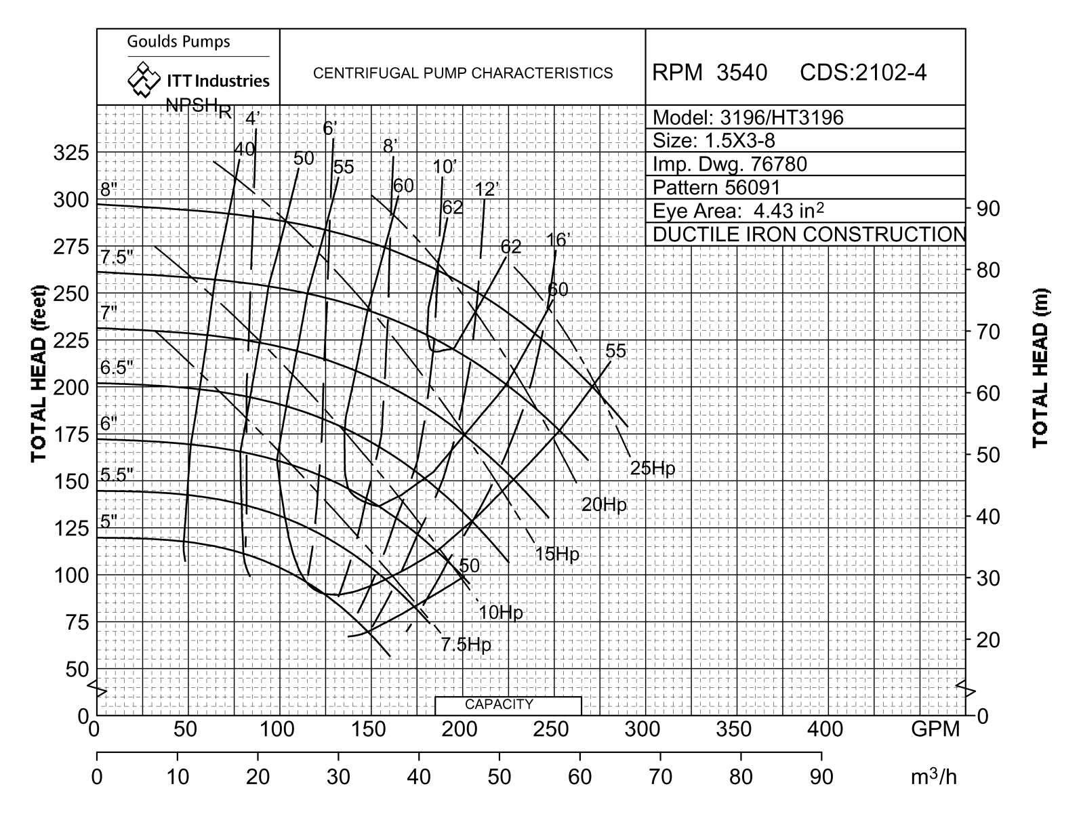
Typical pump characteristic curves

Slide 12
Selecting a pump
System Curve
Head
Meters
Flow (m
3
/hr)

Slide 13
Selecting a pump
Pump Curve at
Const. Speed
82%
Operating Point
System Curve
Head
Meters
500 m³/hr
Flow (m
3
/hr)

Slide 14
Selecting a pump
Pump Curve at
Const. Speed
82%
50
Operating Point
Head,
m
System Curve
300
500
Flow (m
3
/hr)

Slide 15
Selecting a pump
Pump Curve at
Const. Speed
Pump Efficiency
77%
Partially
70
closed valve
82%
50
Full open valve
Head,
m
System Curves
300
500
3
Flow (m
/hr)

Slide 16
Selecting a pump
Pump Curve at
Const. Speed
Pump Efficiency 77%
Partially
B
70 m
82%
closed valve
A
50 m
Full open valve
42 m
System Curves
C
Head
Meters
Static
Operating Points
Head
3
3
300 m
/hr
500 m
/hr
3
Flow (m
/hr)

Slide 17
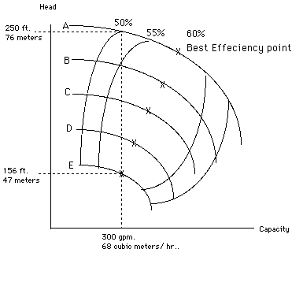
Efficiency Curves
28.6 kW
14.8 kW
Notes:
17
Use the white board and do the following
Assume that we need to pump 68 m3/hr. to a 47 meter head with a pump that is 60% efficient at that point.
Liquid Power - 68 x 47 / 360 = 8.9 Kw
Where ‘360’ is a constant
Shaft Power - 8.9 / 0.60 = 14.8 Kw
Where 0.6 is the efficiency at that point
Motor Power - 14.8 / 0.9 = 16.4 Kw
Where 0.9 is the motor efficiency
As shown in the drawing, we should be using impeller "E" to do this, but we have an oversized pump so we are using the larger impeller "A" with the pump discharge valve throttled back to 68 cubic meters per hour, giving us an actual head of 76 meters.
Now our Kilowatts look like this:
68 x 76 / 360 = 14.3 Kw being produced by the pump, and 14.3 / 0.50 = 28.6 Kw required to do this. Subtracting the amount of kilowatts we should have been using gives us: 28.6 - 14.8 = 13.8 extra kilowatts being used to pump against the throttled discharge valve.
Extra energy used - 8760 hrs/yr x 13.8 = 120,880 kw.
= $ 10,000/annum
In this example the extra cost of the electricity could almost equal the cost of purchasing two or three pumps.

Slide 18
If we select E, then the pump efficiency is 60%
Hydraulic Power = Q (m³/s) x Total head, h_{d} - h_{s} (m) x  (kg/m³) x g (m²/s) 1000
= (68/3600) x 47 x 1000 x 9.81
1000
= 8.7 kW
Shaft Power - 8.7 / 0.60 = 14.5 Kw
Motor Power - 14.8 / 0.9 = 16.1Kw (considering a motor efficiency of 90%)

Slide 19
If we select A, then the pump efficiency is 50%
Hydraulic Power = Q (m³/s) x Total head, h_{d} - h_{s} (m) x  (kg/m³) x g (m²/s) 1000
(68/3600) x 76 x 1000 x 9.81
1000
= 14 kW
Shaft Power - 14 / 0.50 = 28 Kw
Motor Power - 28 / 0.9 = 31 Kw (considering a motor efficiency of 90%)

Slide 20
Using oversized pump !
As shown in the drawing, we should be using impeller "E" to do this, but we have an oversized pump so we are using the larger impeller "A" with the pump discharge valve throttled back to 68 cubic meters per hour, giving us an actual head of 76 meters.
Hence, additional power drawn by A over E is 31 –16.1 = 14.9 kW.
Extra energy used - 8760 hrs/yr x 14.9 = 1,30,524 kw.
= Rs. 5,22,096/annum
In this example, the extra cost of the electricity is more than the cost of purchasing a new pump.

Slide 21
Symptoms that Indicate Potential for Energy Savings
Symptom | Likely Reason | Best Solutions
Throttle valve-controlled systems | Oversized pump | Trim impeller, smaller impeller, variable speed drive, two speed drive, lower rpm
Bypass line (partially or completely) open | Oversized pump | Trim impeller, smaller impeller, variable speed drive, two speed drive, lower rpm
Multiple parallel pump system with the same number of pumps always operating | Pump use not monitored or controlled | Install controls
Constant pump operation in a batch environment | Wrong system design | On-off controls
High maintenance cost (seals, bearings) | Pump operated far away from BEP | Match pump capacity with system requirement

Slide 22

Flow vs Speed
If the speed of the impeller is increased from N₁ to N₂ rpm, the flow rate will increase from Q₁ to Q₂ as per the given formula:
  The affinity law for a centrifugal pump with the impeller diameter held constant and the speed changed:
Flow:
Q1 / Q2 = N1 / N2
Example: 100 / Q₂ = 1750/3500
Q₂ = 200 m³/hr

Slide 23

Head Vs speed
The head developed(H) will be proportional to the square of the quantity discharged, so that
Head:
H1/H2 = (N1²) / (N2²)
Example: 100 /H₂ = 1750 2 / 3500
H₂ = 400 m

Slide 24

Power Vs Speed
The power consumed(W) will be the product of H and Q, and, therefore
Power(kW):
kW1 / kW2 = (N1³) / (N2³)
Example: 5/kW₂ = 17503 / 35003
kW₂ = 40

Slide 25
The affinity law for a centrifugal pump with the speed held constant and the impeller diameter changed
Flow:
Q1 / Q2 = D1 / D2
Example: 100 / Q2 = 8/6
Q2 = 75 m³/hr
Head:
H1/H2 = (D1) x (D1) / (D2) x (D2)
Example: 100 /H2 = 8 x 8 / 6 x 6
H2 = 56.25 m
Horsepower(BHP):
kW1 / kW2 = (D1) x (D1) x (D1) / (D2) x (D2) x (D2)
Example: 5/kW2 = 8 x 8 x 8 / 6 x 6 x 6
kW2 = 2.1 kW

Slide 26
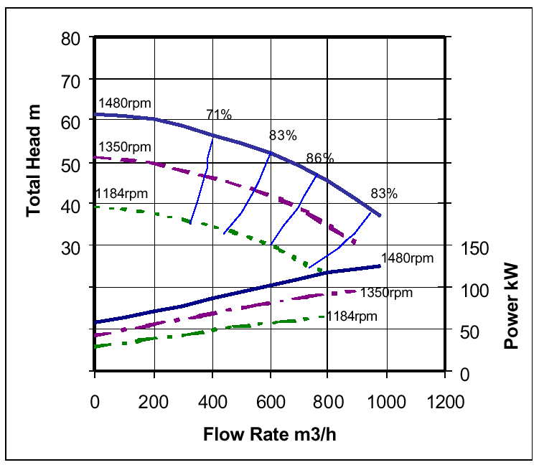
Effect of speed variation

Slide 27
Flow Control Strategies
Reducing impeller diameter
Changing the impeller diameter gives a proportional change in peripheral velocity
Diameter changes are generally limited to reducing the diameter to about 75% of the maximum, i.e. a head reduction to about 50%
Beyond this, efficiency and NPSH are badly affected
However speed change can be used over a wider range without seriously reducing efficiency
For example reducing the speed by 50% typically results in a reduction of efficiency by 1 or 2 percentage points.
It should be noted that if the change in diameter is more than about 5%, the accuracy of the squared and cubic relationships can fall off and for precise calculations, the pump manufacturer’s performance curves should be referred to

Slide 28
Impeller Diameter Reduction on Centrifugal Pump Performance

Slide 29
Pump suction performance (NPSH)
Net Positive Suction Head Available – (NPSHA)
NPSH Required – (NPSHR)
Cavitation
NPSHR increases as the flow through the pump increases
as flow increases in the suction pipework, friction losses also increase, giving a lower NPSHA at the pump suction, both of which give a greater chance that cavitation will occur

Slide 30
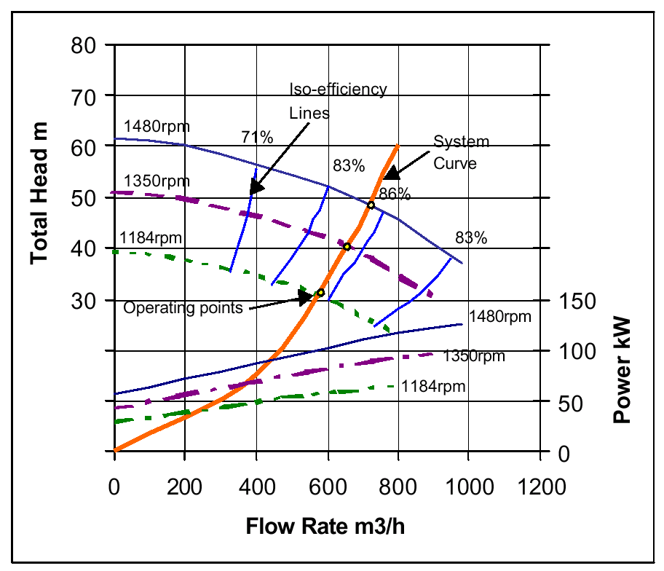
Pump control by varying speed:Pure friction head
Reducing speed in the friction loss system moves the intersection point on the system curve along a line of constant efficiency
The affinity laws are obeyed

Slide 31
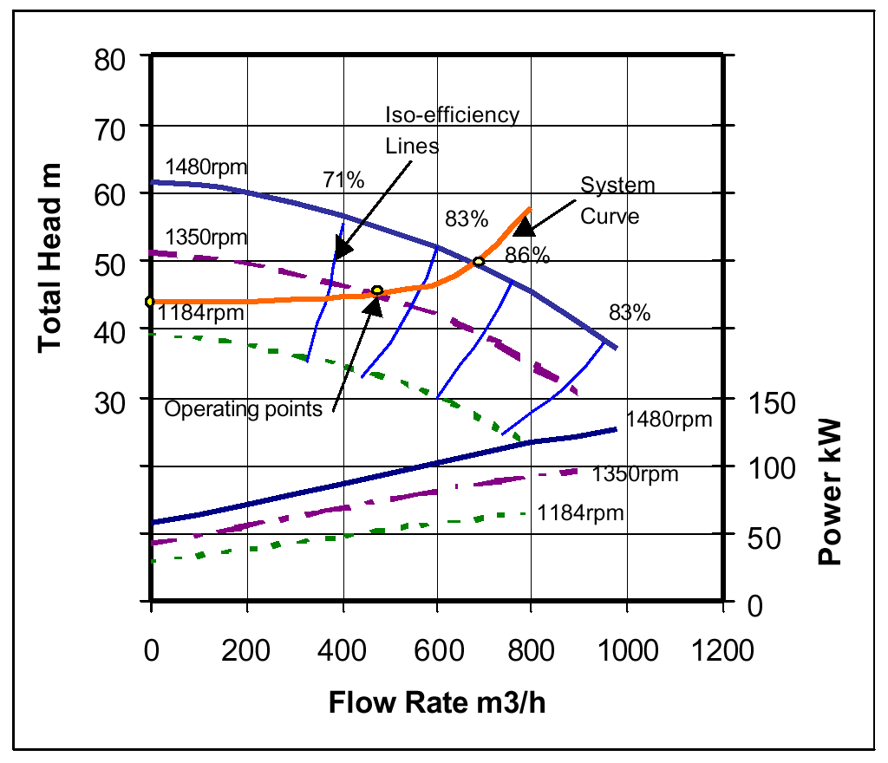
Pump control by varying speed:Static + friction head
Operating point for the pump moves relative to the lines of constant pump efficiency when the speed is changed
The reduction in flow is no longer proportional to speed
A small turn down in speed could give a big reduction in flow rate and pump efficiency
At the lowest speed illustrated, (1184 rpm), the pump does not generate sufficient head to pump any liquid into the system

Slide 32
Pumps in parallel switched to meet demand

Slide 33
Pumps in parallel with system curve

Slide 34
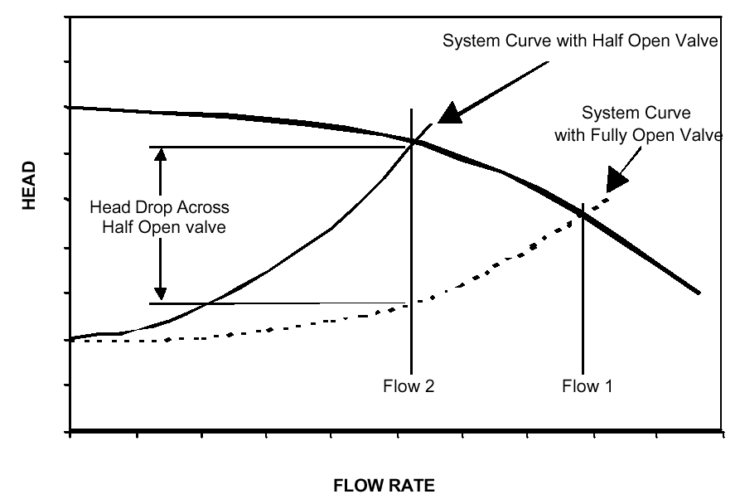
Control of Pump Flow by Changing System Resistance Using a Valve

Slide 35
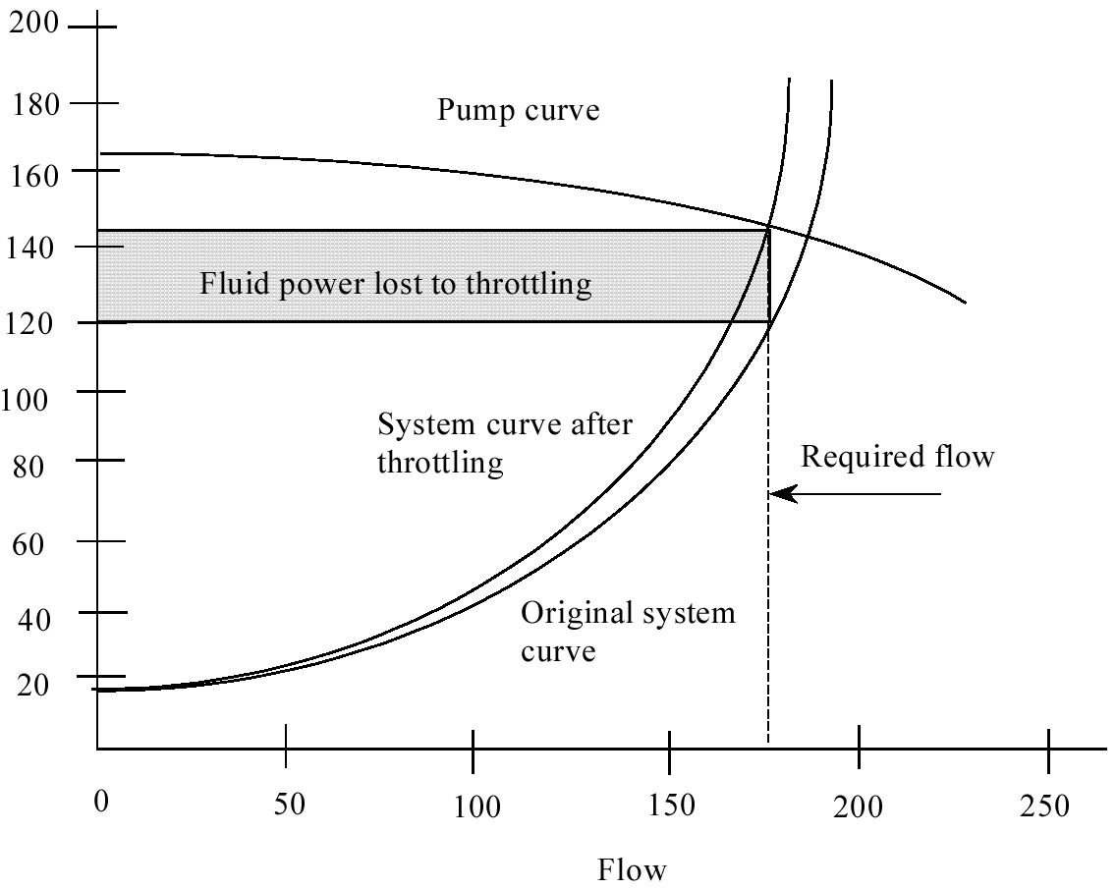
Fixed Flow reduction - Impeller trimming
Before Impeller trimming

Slide 36
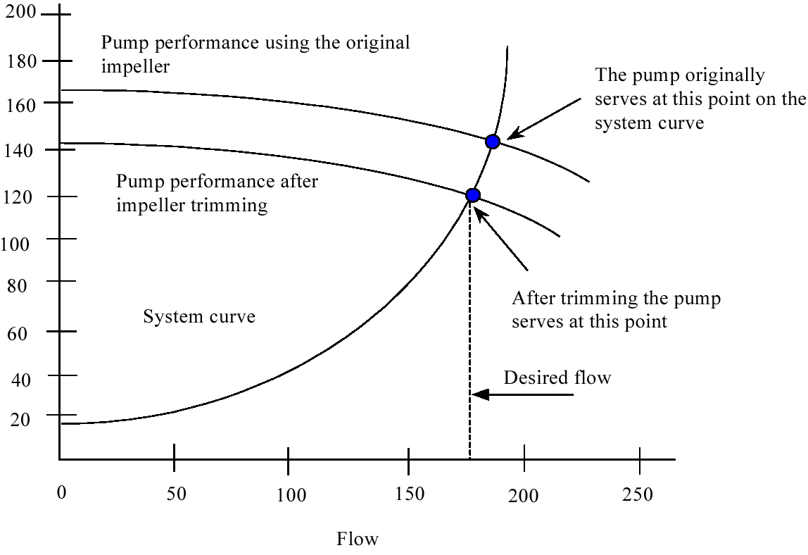
After Impeller Trimming

Slide 37
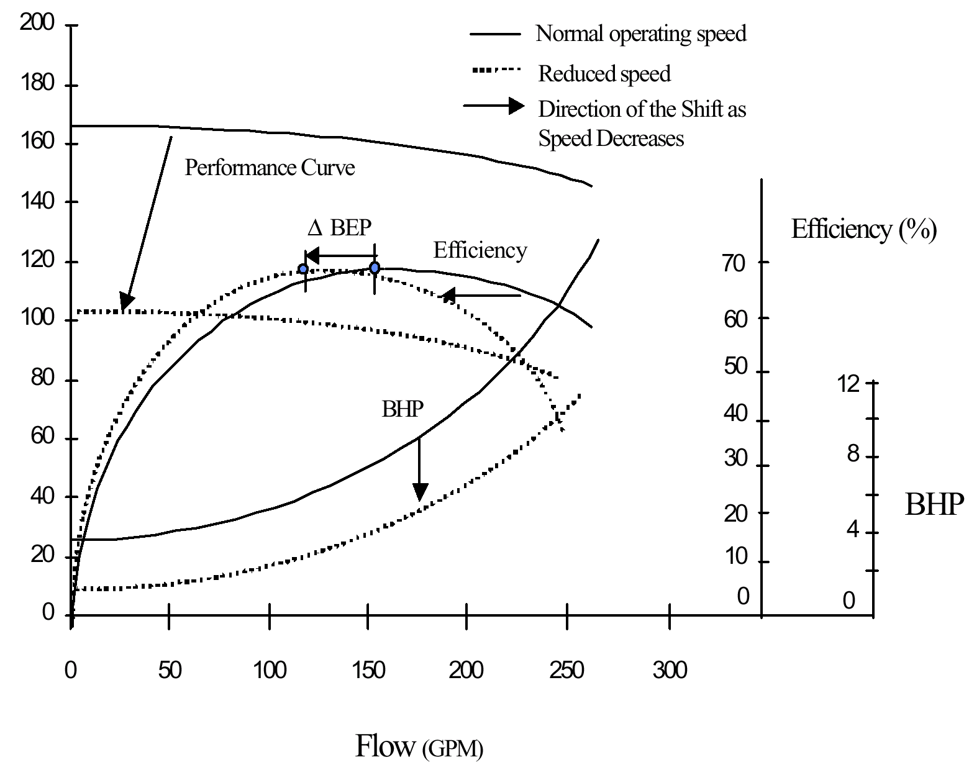
Meeting variable flow reduction -Variable Speed Drives (VSDs)

Slide 38
6.7 Energy Conservation Opportunities in Pumping Systems
Ensure adequate NPSH at site of installation
Operate pumps near best efficiency point.
Modify pumping system/pumps losses to minimize throttling.
Adapt to wide load variation with variable speed drives
Stop running multiple pumps - add an auto-start for an on-line spare or add a booster pump in the problem area.
Conduct water balance to minimise water consumption
Replace old pumps by energy efficient pumps

Slide 39
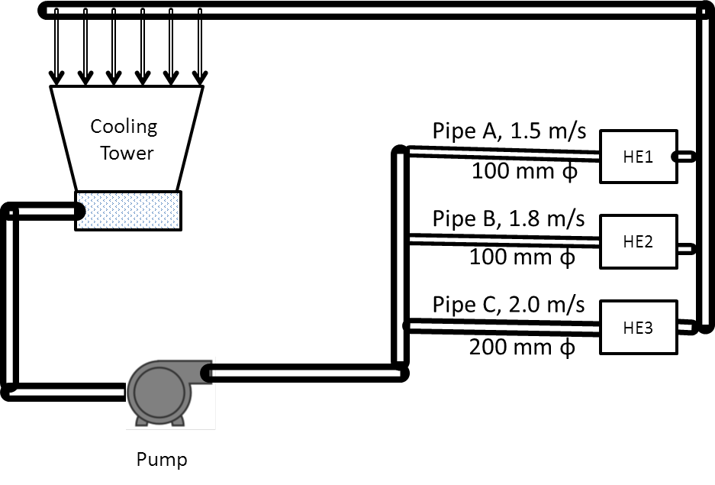
Solved Example:
The cooling water circuit of a process industry is depicted in the figure below. Cooling water is pumped to three heat exchangers via pipes A, B and C where flow is throttled depending upon the requirement. The diameter of pipes and measured velocities with non-contact ultrasonic flow meter in each pipe are indicated in the figure.
The following are the other data:
Measured motor power : 50.7 kW
Motor efficiency at operating load : 90%
Pump discharge pressure : 3.4 kg/cm²
Suction head : 2 meters
Determine the efficiency of the pump.

Slide 40
Flow in pipe A | 22/7 x (0.1)²/4 x 1.5
 | 0.011786 m³/s
Flow in pipe B | 22/7 x (0.1)²/4 x 1.8
 | 0.014143 m³/s
Flow in pipe C | 22/7 x (0.2)²/4 x 2.0
 | 0.062857 m³/s
Total flow | 0.088786 m³/s
Total head | 34 m – 2 m = 32 m
Pump hydraulic power | 0.088786 x 32 x 9.81
 | 27.9 kW
 | 27.9 x 100/50.7 x 0.9
Pump efficiency | 61 %

